Slide 1
Health Care Costs Overview

Slide 2
A Breakdown of Health Care Costs

Slide 3
Health Care Spending
* Does not include RX costs in health care settings
U.S. Government Publishing Office

Slide 4
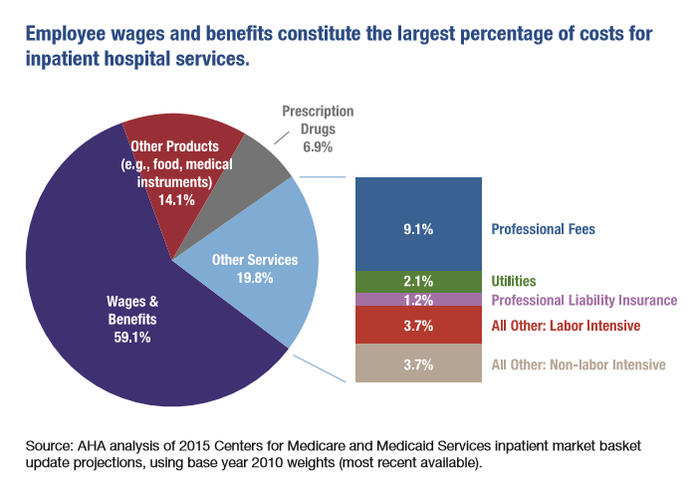
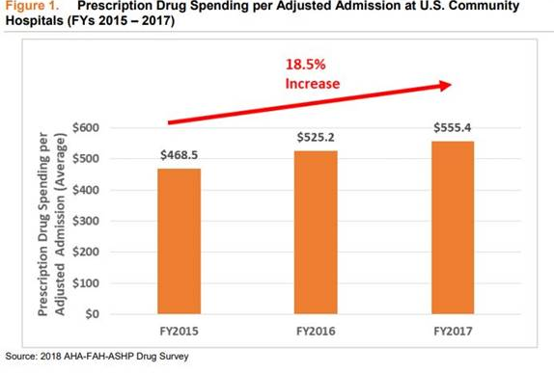
A Breakdown of the Hospital Dollar
Nearly 60% goes to wages & benefits
Drug prices increasing faster than medical inflation

Slide 5
Where Premium Dollar Goes
Hospitals face fixed costs – just like consumers.
Insurance = 13.4¢
Notes:
Hospitals face fixed costs – just like consumers.

Slide 6
RAND Study 2.0
Hospitals and the Employers’ Forum of Indiana agree on the need to reduce health care costs
Hospitals are large employers and are committed to reducing the cost of health care
Unlike direct-to-employer arrangements, hospitals do not see how services are utilized and therefore do not see the overall cost of care employers pay
An APCD would provide transparency into the cost of care
Hospital prices don’t necessarily translate into total employer spend
RAND does not take utilization into account – which impacts total cost of care.
Employees want choice, quality, and convenience

Slide 7
Indiana’s Health Insurance Premiums are Below the National Average
* Indiana Vision 2025 – Indiana Chamber of Commerce

Slide 8
Indiana’s Premiums are Lower than Michigan’s
Source: Kaiser Family Foundation
Notes:
Indiana Ranks xx out of xx.

Slide 9
Economic and Community Benefit of Hospitals

Slide 10
Economic Impact of Indiana’s Hospitals
Significant contributors to Indiana’s economic health
Major employers and purchasers of goods and services
Direct and Indirect Impact on Indiana
Economic Impact
Payroll | $21.9B
Supply Purchases | $14.5B
Capital Spending | $2.7B
Total Impact | $39.1B
243K Jobs Generated by Indiana hospitals | 115K Employees Directly employed by Indiana hospitals

Slide 11
Community Benefit for Indiana’s Not-for-Profit Hospitals
Financial Assistance/Charity | $387,766,585
Medicaid Losses | $785,738,188
Other Means Tested | $19,148,495
Community Health Improvement | $104,873,561
Health Professions Education | $159,681,574
Subsidized Health Services | $53,197,601
Research | $35,030,821
Cash and In-Kind Contributions | $36,007,692
Community Building Activities | $11,795,222
Bad Debt Attributable to Patients Eligible for Financial Assistance | $39,188,127
Medicare Losses | $777,962,560
Total | $2,410,391,426
*Latest Publicly Available Data

Slide 12
Hospital Challenges

Slide 13
Hospital Assessment Fee (HAF)
Hospitals will pay over $1,000,000,000 in fees in State Fiscal Year (SFY) 2019. The fastest growing portion, $200M, supports Healthy Indiana Plan HIP*
Hospitals’ share is increasing at a rapid rate - 55% in the last two years (323% increase for the HIP portion)
Many rural hospitals saw an increase of as much as 40-50% from SFY 2018 to 2019
$1B
FEES PAID BY INDIANA HOSPITALS
*$800M is used to make low hospital reimbursement rates sustainable

Slide 14
How HAF Supports HIP
$
State Budget
HOSPITAL ASSESSMENT
FEE
Indiana Hospitals
$
$
90-100%
FEDERAL MATCH
$
Federal match is declining
Federal Government

Slide 15
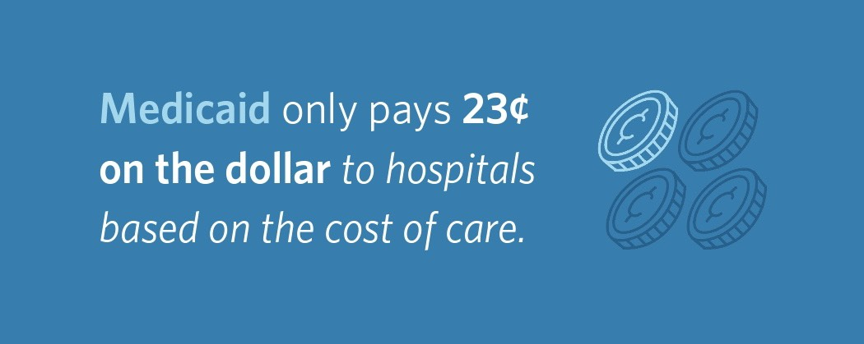
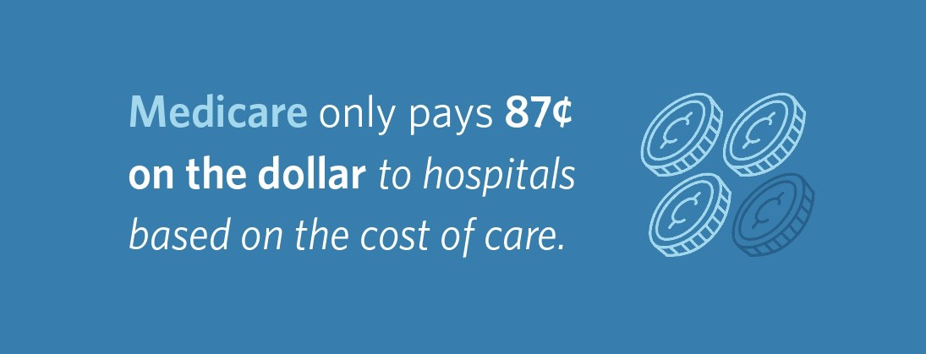
Hospital Challenges: Government Underpayment
*Approximately 50% of all Indiana births are to Medicaid beneficiaries.

Slide 16
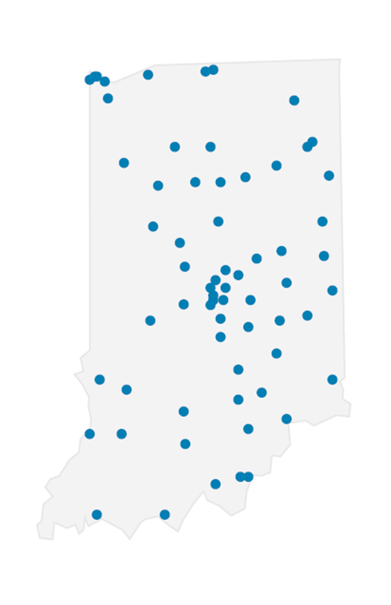
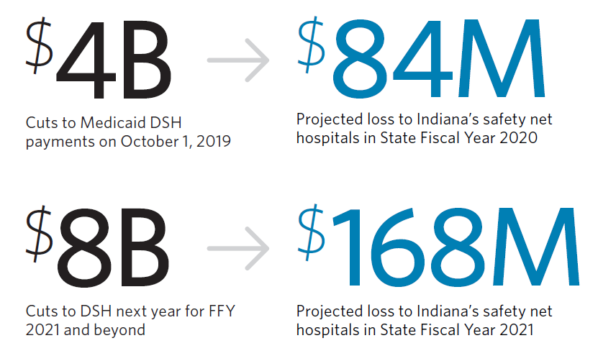
Impact of Scheduled DSH Cuts

Slide 17
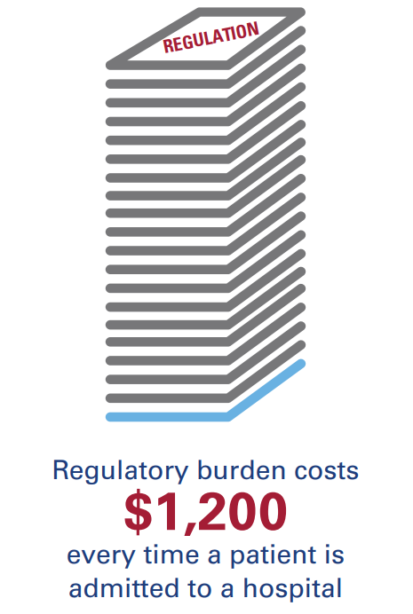
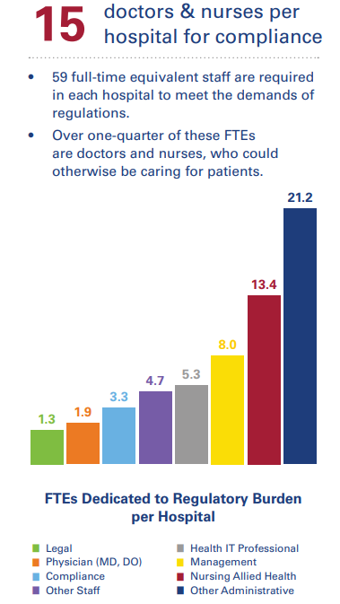
Hospital Challenges: Regulatory Burden
Hospitals have to comply with 341 mandatory regulatory requirements.
Source: Data from the American Hospital Association Report: Regulatory Overload - Accessing Regulatory Burden on Health Systems, Hospitals and Post-acute Care Providers.

Slide 18
Rural Health Care

Slide 19
Rural Healthcare Challenges
Rural hospitals are essential to the health of 60 million Americans who live in rural communities.
Rural population growth has been significantly lower than urban areas, a factor contributing to the closing of 95 rural hospitals across 26 states since 2010.
In Indiana, rural hospitals are fragile.
23.1% of Indiana rural hospitals are at high risk of closing unless their financial situations improve.
Fayette Regional Health System closed in July after filing for bankruptcy in October of 2018
Hoosiers losing Access – OB and ER are especially vulnerable
Notes:
Rural hospitals are essential to the health of the 60 million Americans who live in rural communities. Beyond providing care, they’re also economic engines, often the largest employers and drivers of additional businesses and jobs to communities.
But for close to three decades, rural population growth has been significantly lower than urban areas, a factor contributing to the closing of 95 rural hospitals across 26 states since 2010. And the economic effects are immediate — a Health Services Research study found that when a community loses its hospital, per capita income falls 4% and the unemployment rate rises 1.6%.
A Navigant analysis of the financial viability (total operating margin, days cash on hand, and debt-to-capitalization ratio) of rural hospitals nationwide shows 21% or 430 hospitals across 43 states are at high risk of closing unless their financial situations improve. These hospitals represent 21,547 staffed beds, 707,000 annual discharges, 150,000 employees, and $21.2 billion total patient revenue.
Many rural hospitals are designated as Critical Access Hospitals, meaning they are required to provide a certain number of inpatient beds along with an emergency room. Those requirements often force hospitals that could still be turned around to close instead.
In Indiana, rural hospitals are fragile.
23.1% of Indiana rural hospitals are at high risk of closing unless their financial situations improve.
Fayette Regional Health System closed in July after filing for bankruptcy in October of 2018
Kentuckiana Medical Center closed in April 2019
Hoosiers are already losing access to OB services. Facing low Medicare reimbursements and staffing shortages, more rural hospitals in Indiana and nationally are closing their obstetrics wards. In rural areas, it can be difficult to recoup the costs required to run an obstetrics ward, including expensive monitoring equipment and high staffing needs. The lower population in rural areas means that there are fewer deliveries, and rural areas also have higher proportions of patients paying through Medicaid, contributing to even slimmer margins.

Slide 20
Indiana’s Poor Public Health Metrics

Slide 21
Indiana’s Poor Health Metrics
Indiana ranks 44th among states, down 3 places from 41st in 2017, in the percentage of people who smoke
In the past two years, smoking in Indiana rose 6% while decreasing in many other states
The Bottom 10
41 | Alabama
42 | Alaska
43 | Ohio
44 | Indiana
45 | Mississippi
46 | Arkansas
47 | Tennessee
48 | Louisiana
49 | Kentucky
50 | West Virginia

Slide 22
Indiana Business vs. Health Rankings

Slide 23
The Cost of Poor Health to Employers
An employee who smokes costs their employer $6,000 more per year* than an employee who has never smoked
Tobacco users spend 175% more per person in inpatient, outpatient, and pharmacy costs and have 66% more medical/Rx claims
Tobacco users spend 149% more per person in emergency room visits and are 320% more likely to have an emergency room visit
*Analysis conducted by: Stanley Jackson, Hayden Skirvin, and Kristen Campbell of Apex Benefits

Slide 24
State Solutions

Slide 25
State’s Role in Lowering Healthcare Costs
Support efforts for price and quality transparency
Pass consumer protection legislation to protect Hoosiers from surprise bills
Invest in public health initiatives

Slide 26
IHA Legislative Recommendation
Support efforts for price and quality transparency
Many states are developing/have implemented All Payer Claims Data Bases (APCD)
Allows consumers to see benchmarks for negotiated prices
Pass consumer protection legislation to protect Hoosiers from surprise bills
Invest in public health initiatives
Increasing cigarette tax by $2/pack
Taxing all e-cigarette products
Continue to support efforts to improve infant mortality
Notes:
Increasing cigarette tax by $2/pack
Taxing all e-cigarette products
Continue to support efforts to improve infant mortality

Slide 27
New Care Models

Slide 28
Shift From Fee-for-Service to Value

Slide 29
Shift From Fee-for-Service to Value

Slide 30
Insert Local Example

Slide 31
New Models of Care: The Story of Inspire
More than 5 years ago, Schneck Medical Center in Seymour and Columbus Regional Health in Columbus, IN collaborated to form Inspire, a wholly owned subsidiary
Inspire offers health and wellness programs to local businesses to keep their workforce healthier
Serves employers in Jackson and Bartholomew counties representing 25,000 covered lives
Includes patient-centered medical homes and use of best practices to manage chronic conditions including diabetes
Required a significant investment in predictive analytics, and collaboration/agreement to adopt best practices across 2 different medical staffs
Predictive analytics help predict who will get a chronic condition so intervention can begin early
Adoption of best practices drives down variation and the cost of care

Slide 32
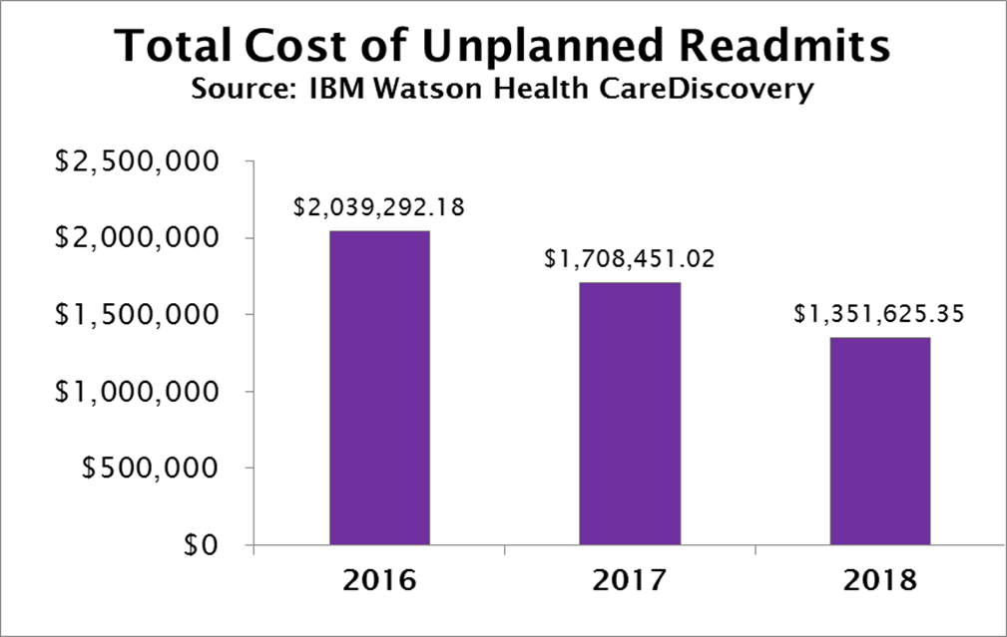
Success in an Inspire Community
2016-2019 YTD Quality Improvement
2016-2019 YTD Medical Utilization/Cost
Quality Improvement Highlights
Seymour Quality | 2016 Average | 2019 YTD Average | Change | % of Change
Colon CA Screening | 63% | 78% | 16% | 25%
Statin Therapy | 4% | 69% | 65% | 1857%
HbA1c Poor Control >9% (Lower is Better) | 23% | 20% | 3% | 11%
HPV Vaccination | 5% | 45% | 40% | 800%
HEDIS Childhood Immunization Status | 6% | 30% | 24% | 392%
HEDIS Wellchild | 66% | 88% | 22% | 33%
PMPM Cost reduced 17%.
IP Hospital Admissions per 1000 members decreased 23%.
IP Hospital Days per 1000 members decreased 35%.
Average Length of Stay was reduced 16%.

Slide 33
Challenges, in Spite of Great Results
Local employers reluctant to invest in health and wellness given lack of immediate return on health and wellness results
High employee turnover makes investing in the long-term health difficult to justify
Local employers with sites outside of Inspire’s geography reluctant to invest locally

Slide 34
Indiana Hospitals: Your Partner in Health

